Slide 1

Department of Computer Science and Engineering
MULTIMODAL CYBERBULLYING DETECTION USING INTER-MODAL-ATTENTION-BASED DEEP LEARNING
PRESENTED BY
Tatapudi Rajesh (22471A05O5)
Panchumarthi Lakshmi Gopinath (22471A05N7)
Chilaka Santhosh (23475A0511)
Under the Guidance of,
Mothe Suneetha M. Tech,
Assistant Professor,
Department of Computer Science and Engineering,
Narasaraopeta Engineering College (Autonomous), Narasaraopet- 522 601.
_
Department of CSE

Slide 2
OUTLINE
Abstract
Introduction
Literature Survey
Research Gaps
Problem Statement
Objectives
Block Diagram / Flow Diagram
Methodology
Implementation
Results and Analysis
Conclusion & Future Scope
References
Acknowledgements
Question and Answers
_
Department of CSE

Slide 3
ABSTRACT
Cyberbullying on social media continues to affect users emotionally and socially, creating an urgent need for automated detection systems that can interpret both language and visuals.
In this, designed a multimodal framework that learns from text and image data using an inter-modal attention mechanism. The text is represented through BERT embeddings, while BLIP is applied to generate image captions and visual context. These representations are then fused and processed through BiLSTM layers to recognize bullying cues. Along with classification, the system performs input validation, NSFW screening, and assigns severity and category levels to each post. Experiments conducted on the MMHS150K dataset show an accuracy of 87.2\%, precision of 85.6\%, recall of 84.9\%, and an F1-score of 85.2\%, surpassing prior methods such as SAFE, MCNN, and LBP-sim.The framework is lightweight, interpretable, and adaptable for real-time content moderation across social media platforms.
_
Department of CSE

Slide 4
INTRODUCTION
Brief Introduction of the Project
This project focuses on detecting cyberbullying in social media posts using a multimodal deep learning framework that integrates both text and image features.
It leverages inter-modal attention mechanisms to enhance understanding of harmful content and improve classification accuracy.
Motivation Behind the Project
With the rapid growth of social media, online harassment has become a serious concern affecting users’ mental health and online safety.
This project aims to build an intelligent system that can automatically identify and prevent cyberbullying before it escalates.
Importance and Relevance
Cyberbullying detection is crucial for maintaining a safer digital environment.
By combining visual and textual cues, this system offers a more accurate and context-aware solution, aiding platforms and policymakers in promoting responsible online behavior.
_
Department of CSE

Slide 5
LITERATURE SURVEY
No | Title | Author | Journal Name & Year | Methodology Adapted | Key Findings | Gaps
1 | An inter-modal attention-based deep learning framework using unified modality for multimodal fake news, hate speech, and offensive language detection | Ayetiran & Ozgobek, 2024, Elsevier | https://www.sciencedirect.com/science/article/pii/S0306437924000378 | BiLSTM-CNN + Inter-modal Attention (model architecture/components) | They achieved state-of-the-art results by combining image and text, creating a truly unified representation. | There is no much explainability, only a "yes/no" answer for classification, and it demands a lot of computing power.
2 | Cyberbullying Detection Based on Emotion | Al-Hashedi et al., 2023, IEEE | https://ieeexplore.ieee.org/document/10138186 | BERT, XLNet (as core models) + emotion classifier (specific model/component) | They got 97% F1 score for emotions, 92% for bullying texts. | It only works for one language, and getting humans to label all that data is super expensive.
3 | Ensemble Learning With Tournament Selected Glowworm Swarm Optimization Algorithm for Cyberbullying Detection on Social Media | Ravuri Daniel et al., 2023, IEEE | https://ieeexplore.ieee.org/document/10292654 | GloVe (as an embedding technique/feature representation) + ELSTM-AB (model) | They got 96.4% accuracy and making predictions in just 0.32 seconds. | Can't handle pictures or videos and hasn't been tested in real-time situations yet.
4 | Toward Multi-Modal Approach for Identification and Detection of Cyberbullying in Social Networks | Al-Khasawneh et al., 2024, IEEE | https://ieeexplore.ieee.org/document/10574823 | BiLSTM + Hierarchical Attention, MLP for fusion (all are model components/architectures) | 92.1% accuracy for Twitter and 86.4% F1 for Instagram. | No tests on image or video content. Plus, you'll need a powerful GPU.
5 | Multilingual Detection of Cyberbullying in Mixed Urdu, Roman Urdu, and English Social Media Conversations | Razi & Ejaz, 2024, IEEE | https://ieeexplore.ieee.org/document/10608139 | mBERT/MuRIL (as core models) + weighted harm scoring (specific logic/algorithm) | They got 92% F1-score and, big news, created the first cyberbullying dataset that works in three languages. | No images or videos, and it only tells you "yes" or "no" for bullying (binary classification).
_
Department of CSE

Slide 6
RESEARCH GAPS
1. Limited Explainability
There is no much explainability, only a "yes/no" answer for classification, and it demands a lot of computing power.
2. High Computational Demand
It only works for one language, and getting humans to label all that data is super expensive.
3. Restriction
Can't handle pictures or videos and hasn't been tested in real-time situations yet.
4. Lack of Multimodal Support
No tests on image or video content. Plus, you'll need a powerful GPU.
5. Limited Real-Time Evaluation
No images or videos, and it only tells you "yes" or "no" for bullying (binary classification).
_
Department of CSE

Slide 7
PROBLEM STATEMENT
Main Issue
Cyberbullying on social media platforms has become a growing threat, negatively impacting users’ mental health and online safety.
Existing Limitations
Current detection systems mainly rely on textual data, lack explainability, and fail to process multimodal content like images.
Core Problem
There is no unified and efficient framework that can accurately detect, explainability and interpret cyberbullying from both text and visual data in real time.
Goal
To develop a multimodal deep learning model that integrates text and image features using inter-modal attention, enabling accurate, explainable, and real-time cyberbullying detection.
_
Department of CSE

Slide 8
OBJECTIVES
To develop an Inter-modal-attention-based Deep Learning for accurate and efficient Cyberbullying detection.
Specific Objectives
To develop a multimodal deep learning framework that effectively combines textual and visual features for cyberbullying detection.
To implement an inter-modal attention mechanism that enhances the interaction between text and image modalities for better contextual understanding.
To improve the accuracy and robustness of detection compared to existing single-modality or traditional models.
To ensure scalability and efficiency by optimizing the model for real-time prediction on social media data.
To provide interpretable outputs that help moderators understand why a post is flagged as cyberbullying.
_
Department of CSE

Slide 9
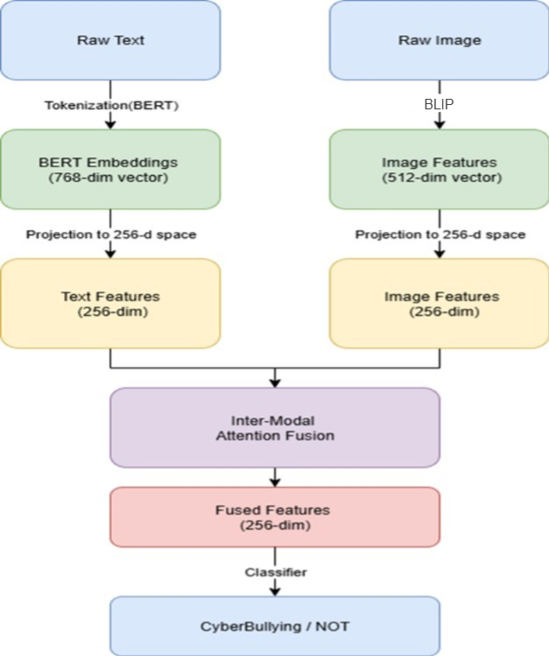
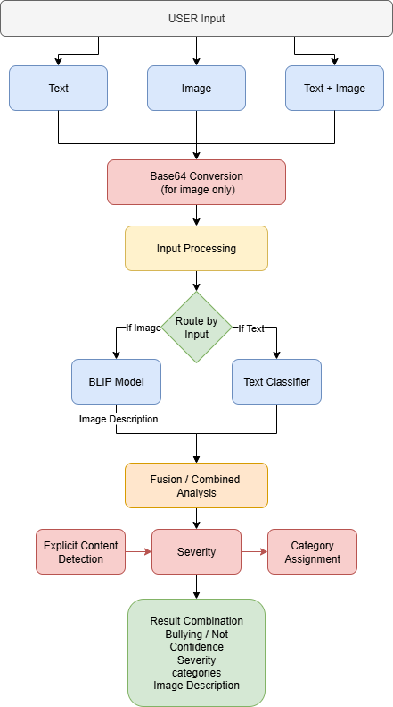
BLOCK DIAGRAM OR FLOW DIAGRAM
_
Department of CSE

Slide 10
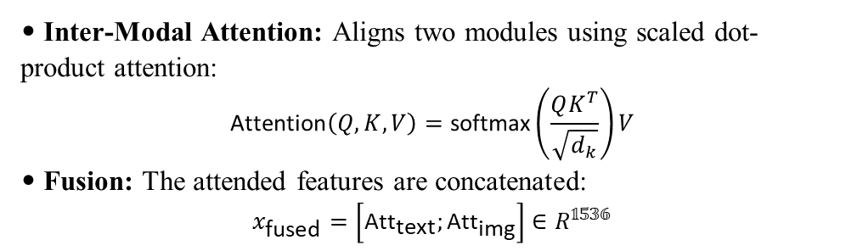
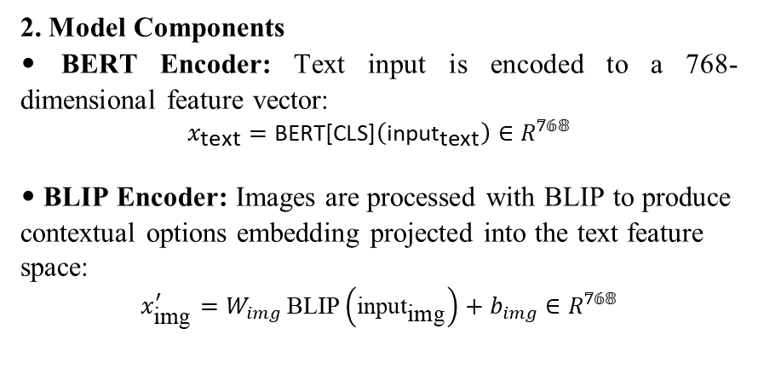
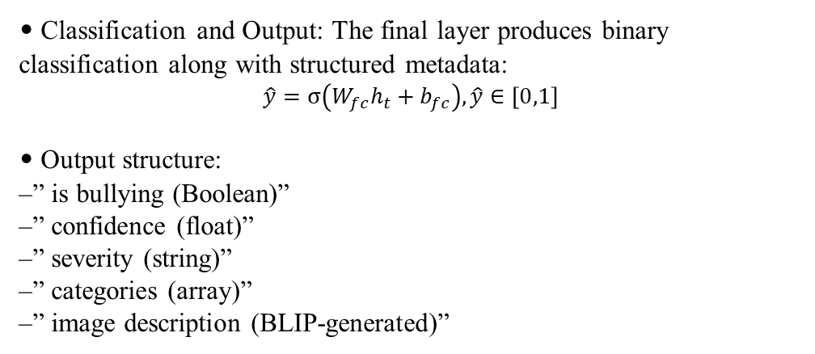
METHODOLOGY
Methods and Approaches (BERT + BLIP)
1. Preprocessing
Remove emojis, URLs, hashtags, mentions, and punctuation. Convert all text to lowercase.
Tokenize using the BERT tokenizer and truncate to 128 tokens.
Resize every images to 224 * 224 pixels.
• Inter-Modal Attention: Aligns two modules using scaled dot-product attention:
$$\text{Attention}\left(Q,K,V\right)=\text{softmax}\left(\frac{QK^{T}}{\sqrt{d_{k}}}\right)V$$
• Fusion: The attended features are concatenated:
$$x_{\text{fused}}=\left[{\text{Att}}_{\text{text}};{\text{Att}}_{\text{img}}\right]∈R^{𝟙𝟝𝟛𝟞}$$
2. Model Components
• BERT Encoder: Text input is encoded to a 768-dimensional feature vector:
$$x_{\text{text}}=\text{BERT}\text{[}\text{CLS}\text{]}\left({\text{input}}_{\text{text}}\right)∈R^{𝟟𝟞𝟠}$$
• BLIP Encoder: Images are processed with BLIP to produce contextual options embedding projected into the text feature space:
$$x_{\text{img}}^{′}=W_{img} \text{BLIP}\left({\text{input}}_{\text{img}}\right)+b_{img}∈R^{𝟟𝟞𝟠}$$
• Classification and Output: The final layer produces binary classification along with structured metadata:
$$\hat{y}=σ\left(W_{fc}h_{t}+b_{fc}\right),\hat{y}∈\left[0,1\right]$$
• Output structure:
–” is bullying (Boolean)”
–” confidence (float)”
–” severity (string)”
–” categories (array)”
–” image description (BLIP-generated)”
‘R’ just means the vector is made up of normal real numbers, representing the numeric features used by the model.
_
Department of CSE

Slide 11
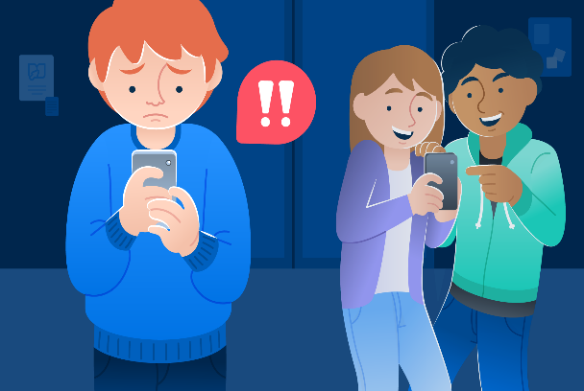
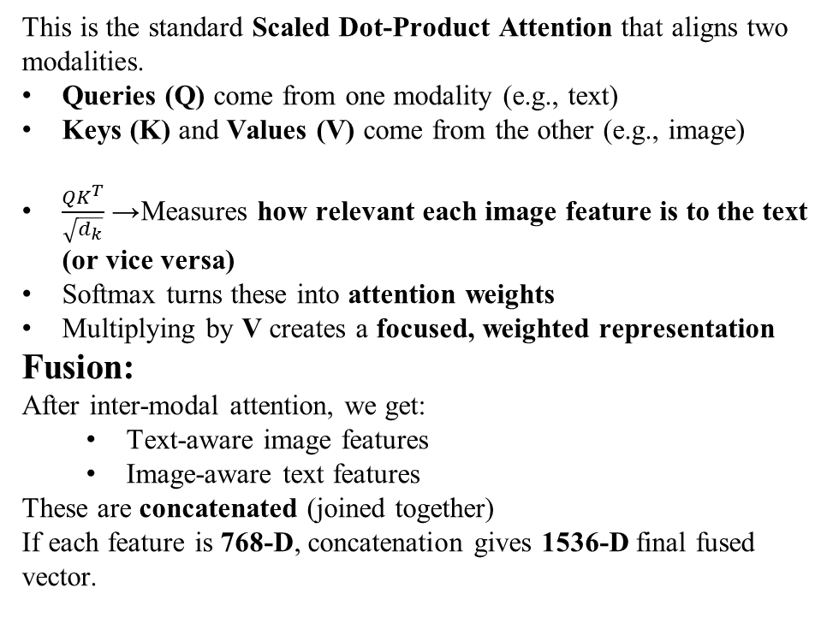
METHODOLOGY
Inter-Modal Attention Fusion Mechanism
This is the standard Scaled Dot-Product Attention that aligns two modalities.
Queries (Q) come from one modality (e.g., text)
Keys (K) and Values (V) come from the other (e.g., image)
$\frac{QK^{T}}{\sqrt{d_{k}}}$→ Measures how relevant each image feature is to the text (or vice versa)
Softmax turns these into attention weights
Multiplying by V creates a focused, weighted representation
Fusion:
After inter-modal attention, we get:
Text-aware image features
Image-aware text features
These are concatenated (joined together)
If each feature is 768-D, concatenation gives 1536-D final fused vector.
Text Provided by User
“This loser should stop posting selfies.
Nobody wants to see your stupid face.”
Image Provided by User
(Example shown above — assume it is
a picture of a person posting a selfie.)
Now the model (Inter-Modal Attention) tries to understand:
“How does the text relate to the image?”
Example Interpretation
The text insults someone taking a selfie
Image shows a person taking a selfie
High alignment → HIGH bullying probability
Attention checks:
Does the word “loser” relate to the person in image? → Yes
Does “stupid face” refer to the face in the photo? → Yes
The model strengthens this relationship using attention weights.
_
Department of CSE

Slide 12
IMPLEMENTATION
Implementation:
Built on Google Colab (Python, PyTorch) using MMHS150K dataset.
Integrated BERT for text + BLIP for image encoding.
Model trained, validated, and saved as cyberbullying_model.pth.
Software Specs:
OS: Colab (Windows)
Frameworks: PyTorch, HuggingFace, Scikit-learn
Tools: Pandas, NumPy, Matplotlib,…..
Hardware Specs:
GPU: NVIDIA Tesla T4 (16 GB VRAM)
RAM: 13 GB | Storage: 100 GB (Google Drive)
Challenges & Solutions:
Data imbalance → Weighted loss & sampler
Noisy text and images → Text cleaning & image resizing
Overfitting → Early stopping & dropout
Slow training → GPU acceleration
_
Department of CSE

Slide 13
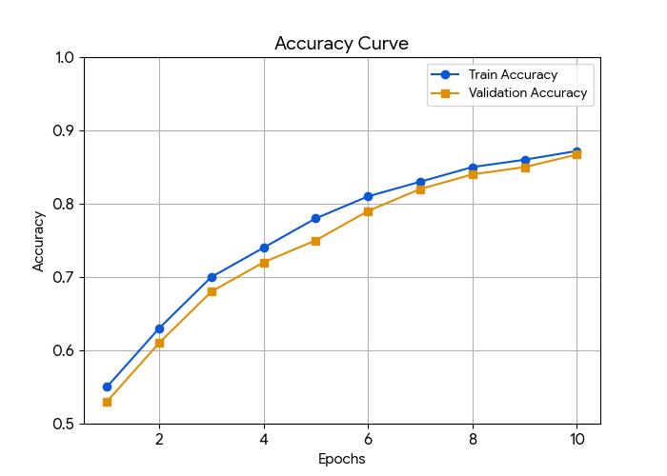
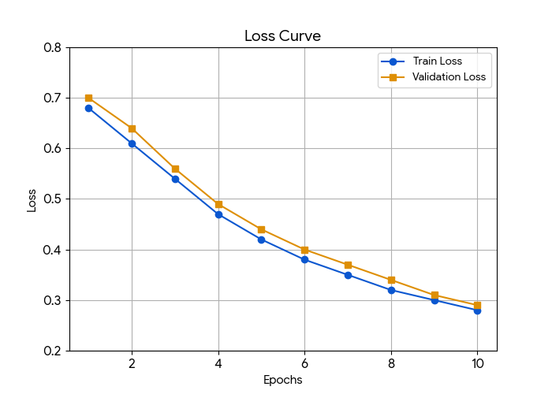
RESULTS & ANALYSIS
Training Progress
The Training & Validation Accuracy and Loss curves show how model performance improved over epochs.
Loss Curve: Gradual decrease → effective learning.
Accuracy Curve: Increased steadily → balanced accuracy.
Early stopping applied to prevent overfitting once validation loss is stabilized.
Final F1 score achieved around 0.852, ensuring both precision and recall stability.
Visual Insight:
Smooth convergence of loss curve shows good generalization.
Parallel rise in validation metrics indicates consistent learning.
_
Department of CSE

Slide 14
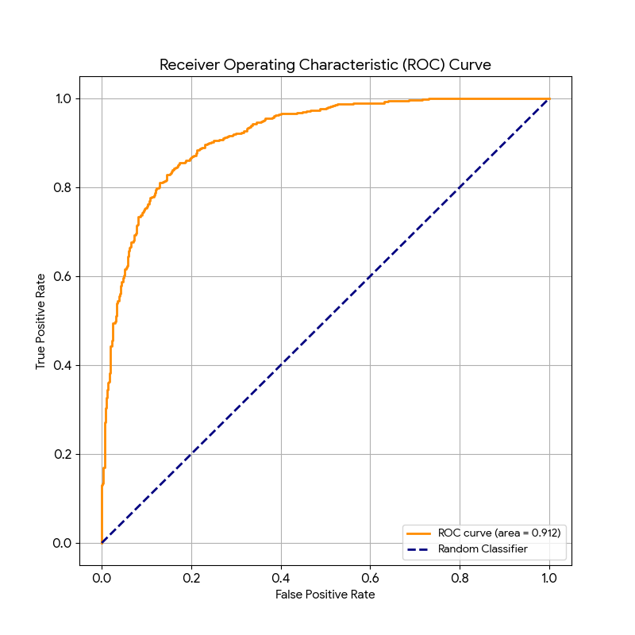
RESULTS & ANALYSIS
The ROC curve evaluates how well the model distinguishes between Bullying and Non-Bullying.
X-axis: False Positive Rate (FPR)
Y-axis: True Positive Rate (TPR)
The AUC (Area Under Curve) value close to 1.0 indicates strong model performance.
Our model achieved a high AUC (>0.912), showing excellent separation capability between classes.
Interpretation:
Curve near the top-left corner → better detection.
Indicates low false positives and high true detection of bots.
_
Department of CSE

Slide 15
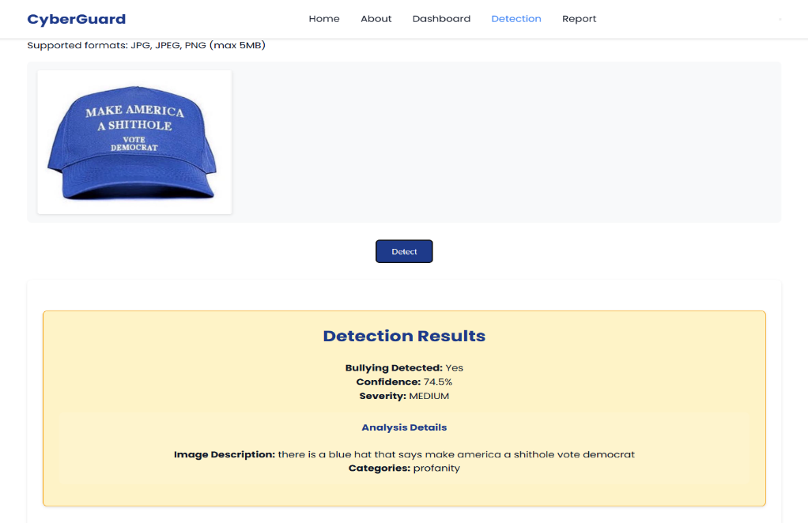
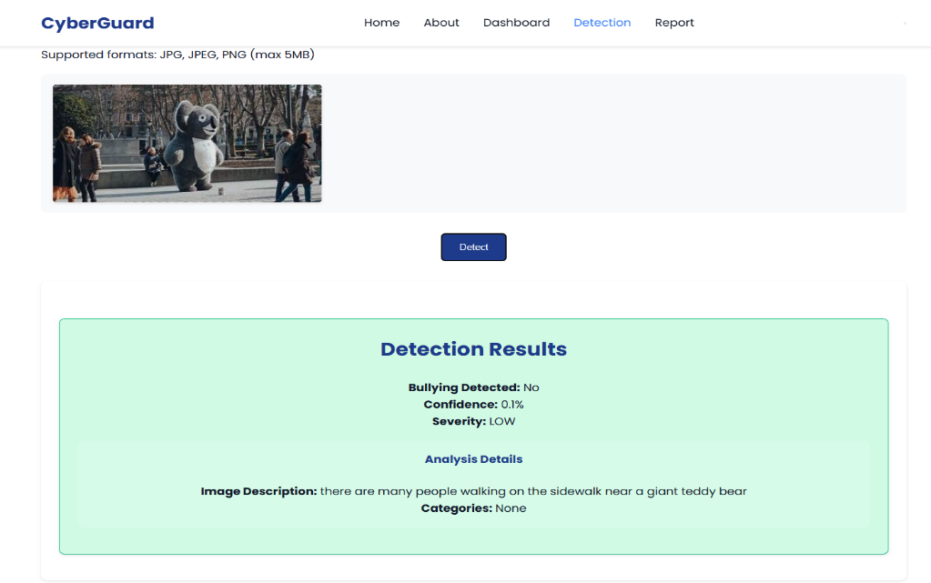
RESULTS & ANALYSIS
Bullying: YES/NO Classification Results
The classification visualization highlights the model’s predictions:
Orange/Red: Bullying detected.
Green: No Bullying detected.
The model learns to detect bullying by analyzing abusive or hateful language in text and harmful or offensive cues in images through inter-modal attention.
Bullying: Posts containing abusive language, hate speech, threats, or offensive images indicating harm or harassment.
Not Bullying: Posts with neutral, friendly, or informative text and non-offensive images showing no intent to harm.
Achieved 87.2% accuracy in Bullying or Not detection.
_
Department of CSE

Slide 16
CONCLUSION and FUTURE SCOPE
Key Findings
Achieved 87.2% accuracy and F1-score of 0.852 on MMHS150K dataset.
BERT + BLIP + inter-modal attention model outperformed single-branch models (text-only).
The model learned semantic meaning from BERT text embeddings, visual context from BLIP image encoder, and used inter-modal attention to align and fuse these features—capturing relationships between words and visuals for accurate cyberbullying detection.
Demonstrated strong generalization with AUC > 0.912 and low false detection rate.
Significance of Results
These results highlight the model’s suitability for real-world social media moderation systems.
It enhances context understanding, improves classification performance, and provides a foundation for developing real-time, and explainable online safety systems.
The proposed framework is highly adaptable, allowing integration with various social media platforms and making it suitable for diverse online environments.
_
Department of CSE

Slide 17
CONCLUSION and FUTURE SCOPE
Future Developments
Several directions can further enhance the model’s effectiveness:
Multilingual Handling: Adoption of models such as XLM-RoBERTa for improved support of code-mixed and regional content.
Deployment Optimization: Application of pruning or quantization for faster inference in real-time moderation systems.
Robustness: Enhancement of resistance to adversarial inputs such as obfuscated text or modified images.
Limitations
Currently trained on English data, limiting performance on multilingual or code-mixed content.
The framework currently processes only text and images, excluding videos or audio cues that may indicate bullying behavior.
_
Department of CSE

Slide 18
REFERENCES
[1] UNICEF (2019): Reported that over one-third of young people across 30 countries experience online bullying, emphasizing the global scale of the issue.
[2] Gillespie (2018): Discussed how content moderation shapes online discourse, revealing the complex role of platforms in managing harmful content.
[3] Meta Platforms Inc. (2023): Outlined Meta’s policies and community standards for moderating online abuse and enforcing safe digital spaces.
[4] Joachims (1998): Introduced Support Vector Machines for text categorization, forming a foundational approach for modern text-based classification.
[5] Shaik Rafi et al. (2025): Developed a sarcasm detection system across headlines and text, contributing to better sentiment and intent understanding.
[6] Devlin et al. (2019): Proposed BERT, a bidirectional transformer model that revolutionized contextual text representation for NLP tasks.
[7] Ayetiran & Ozgobek (2024): Presented an inter-modal attention framework integrating text and image modalities for multimodal content analysis.
_
Department of CSE

Slide 19
REFERENCES
[8] Reddy et al. (2025): Implemented CNN-based deep learning for automated traffic sign recognition, demonstrating efficient visual feature extraction.
[9] Al-Khasawneh et al. (2024): Proposed a multimodal approach for detecting cyberbullying using combined textual and visual cues from social networks.
[10] Al-Hashedi & Maheshwari (2023): Designed an emotion-based cyberbullying detection model leveraging affective features from textual content.
[11] Ravuri Daniel (2023): Utilized ensemble learning with optimization algorithms to improve cyberbullying detection accuracy on social media.
[12] Razi & Ejaz (2024): Developed a multilingual cyberbullying detection system handling Urdu, Roman Urdu, and English social media posts.
[13] Jamjoom & Majeed (2024): Enhanced RoBERTa with GloVe features to improve transformer-based cyberbullying detection performance.
[14] Daraghmi & Basulaiman (2024): Proposed a CNN-BiLSTM-GRU hybrid model for effective Arabic cyberbullying detection from text data.
[15] Naqvi & Atif (2024): Focused on detecting cyberbullying and profiling abusers in Roman Urdu social media interactions.
_
Department of CSE

Slide 20
REFERENCES
[16] Ibrahim & Ben Ali (2024): Introduced a neural network-based hate speech detection framework incorporating uncertainty modeling for robustness.
[17] Gomez et al. (2020): Created a benchmark dataset and baseline models for multimodal hate speech detection combining text and images.
[18] Alfurayj & Shah (2024): Proposed a chained deep learning model capturing bystander dynamics for fine-grained cyberbullying detection.
[19] Moturi et al. (2024): Applied CNNs on gammatonegram features for detecting abnormalities in PCG signals, showcasing signal analysis via deep learning.
[20] Venkatareddy et al. (2024): Presented deep learning-based innovations in communication and computing technologies for modern applications.
[21] Greeshma et al. (2022): Discussed deep learning advances in network systems, offering insights into neural model integration across domains.
[22] Jagannadham et al. (2021): Explored IoT and cloud-driven architectures, focusing on scalable, intelligent computing solutions.
[23] Ayetiran & Ozgobek (2024): Developed an inter-modal attention-based deep learning framework using unified modality for multimodal cyberbullying detection.
_
Department of CSE

Slide 21
ACKNOWLEGEMENTS
Thank You!
We sincerely thank the Co-ordintor’s, faculty, and audience for giving us the opportunity to present our project — “MULTIMODAL CYBERBULLYING DETECTION USING
INTER-MODAL-ATTENTION-BASED DEEP LEARNING”
Your attention, feedback, and questions are truly appreciated. For any further discussions or collaboration inquiries, feel free to contact us:
Contact Information
Tatapudi Rajesh – rajeshtatapudi1819@gmail.com
Mothe Suneetha – msuneetha973@gmail.com
Panchumarthi Lakshmi Gopinath – gsgopinath3@gmail.com
Chilaka Santhosh– chilakasanthosh11@gmail.com
_
Department of CSE

Slide 22
QUESTIONS and ANSWERS
Thank You! From DB7
We appreciate your attention and interest. Now, we’d like to open the floor for questions and discussions.
💬 Feel free to ask about the model, dataset, or future work!
_
Department of CSE

